Slide 1


STOCKIFY
Simplify Investments, Amplifying Returns

Slide 2






GROUP MEMBERS
Suyesha Lamne
Prachi Chatur
Priyanka Ramesh
Mukul Desai
Ramy Solanki

Slide 3

STOCKIFY
StockiFy aims to provide users with a comprehensive and user-friendly platform for stock trading. The platform will leverage cutting-edge technologies to offer intelligent features and tools to enhance the trading experience. With an intuitive interface and robust backend infrastructure, it will cater to both novice investors and seasoned traders.

Slide 4

FEATURES
User Registration/Login
Dashboard/ Portfolio
Real-time Market Data/ News
Stock Search
Settings

Slide 5

USER REGISTRATION/ LOGIN
When a user visits the Stockify website for the first time, they are typically prompted to create an account.
Once a user has registered, they can log in to their account using their chosen username and password.

Slide 6
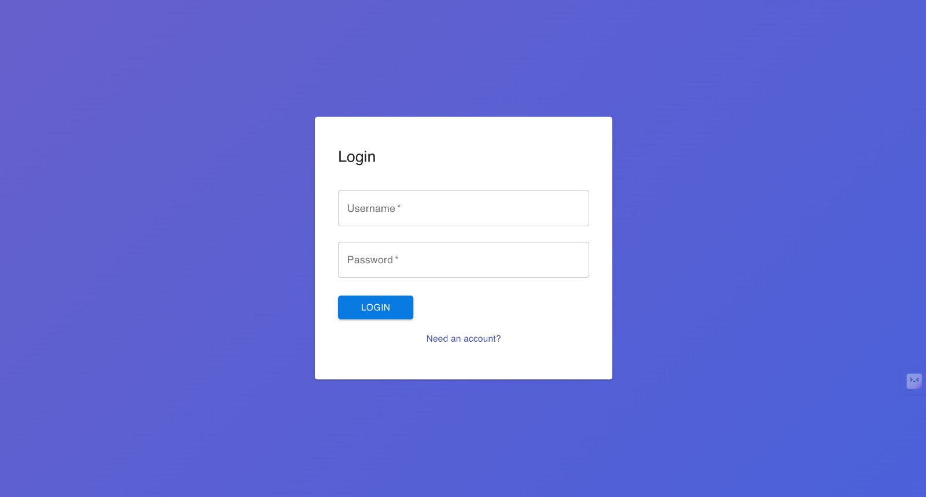

Slide 7
DASHBOARD
Available Funds: Displays the current balance available in the user’s account.
Stocks You Bought: Summarizes owned stocks.
Real-time Stock Graph: Shows dynamic price movements of selected stocks or indices, aiding in decision-making.
Users can purchase or sell stocks.

Slide 8
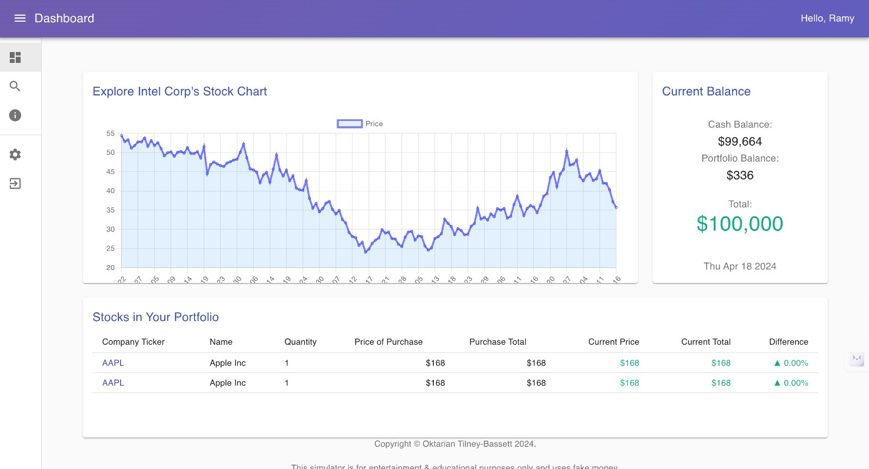

Slide 9
REAL-TIME MARKET DATA/ NEWS
Real-time Market Data/News provides instant updates on stock prices, market indices, and relevant news, helping users stay informed about current market conditions and make timely investment decisions.

Slide 10
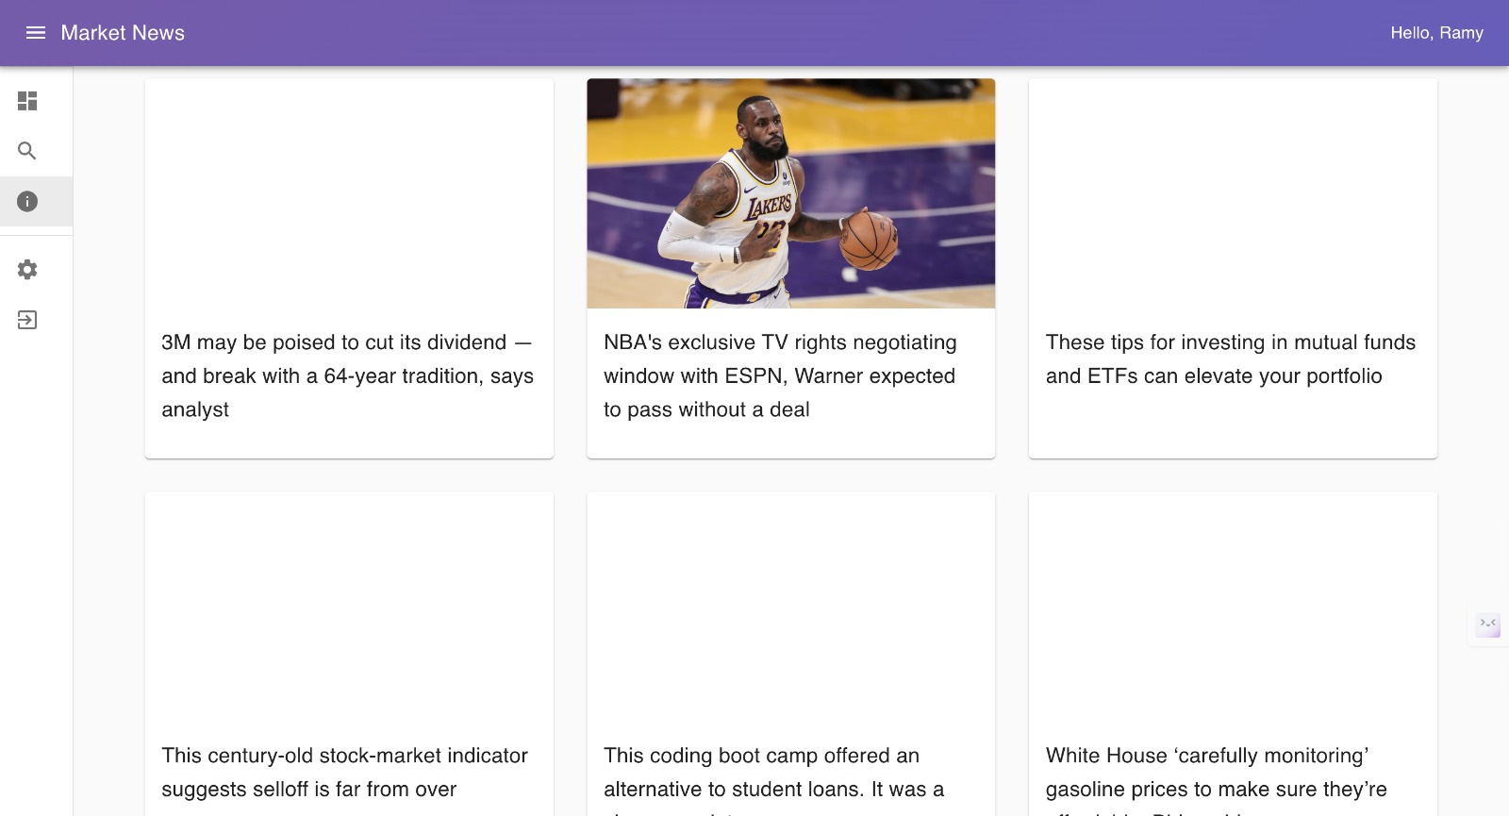

Slide 11
STOCK SEARCH
Stock Search allows users to find specific stock information through a convenient search function.
This feature streamlines the process of conducting research and making informed investment decisions by providing comprehensive data on individual stocks within the trading platform.

Slide 12
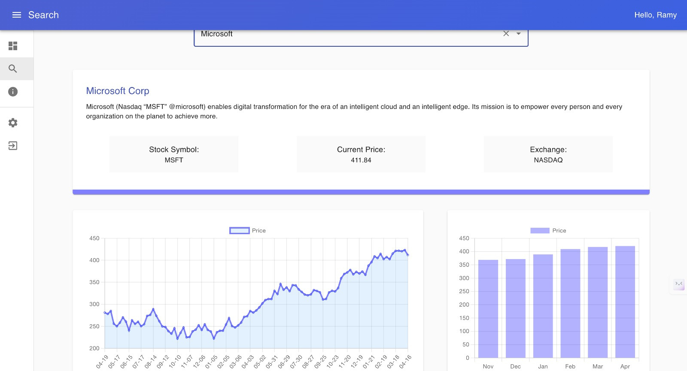

Slide 13
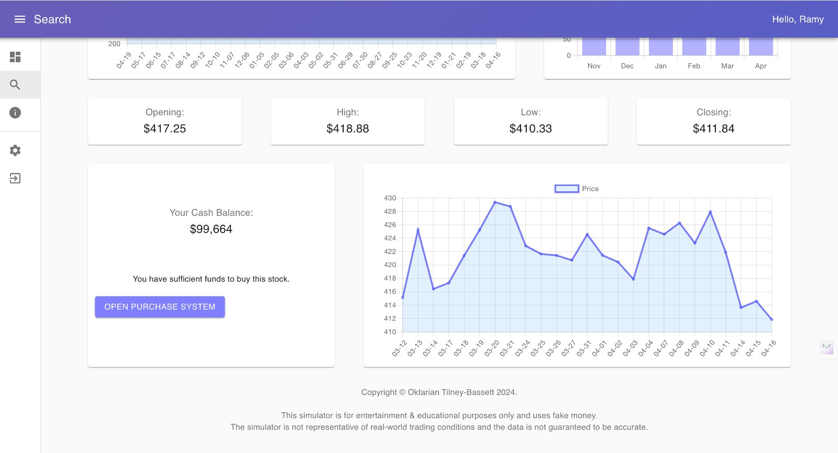

Slide 14
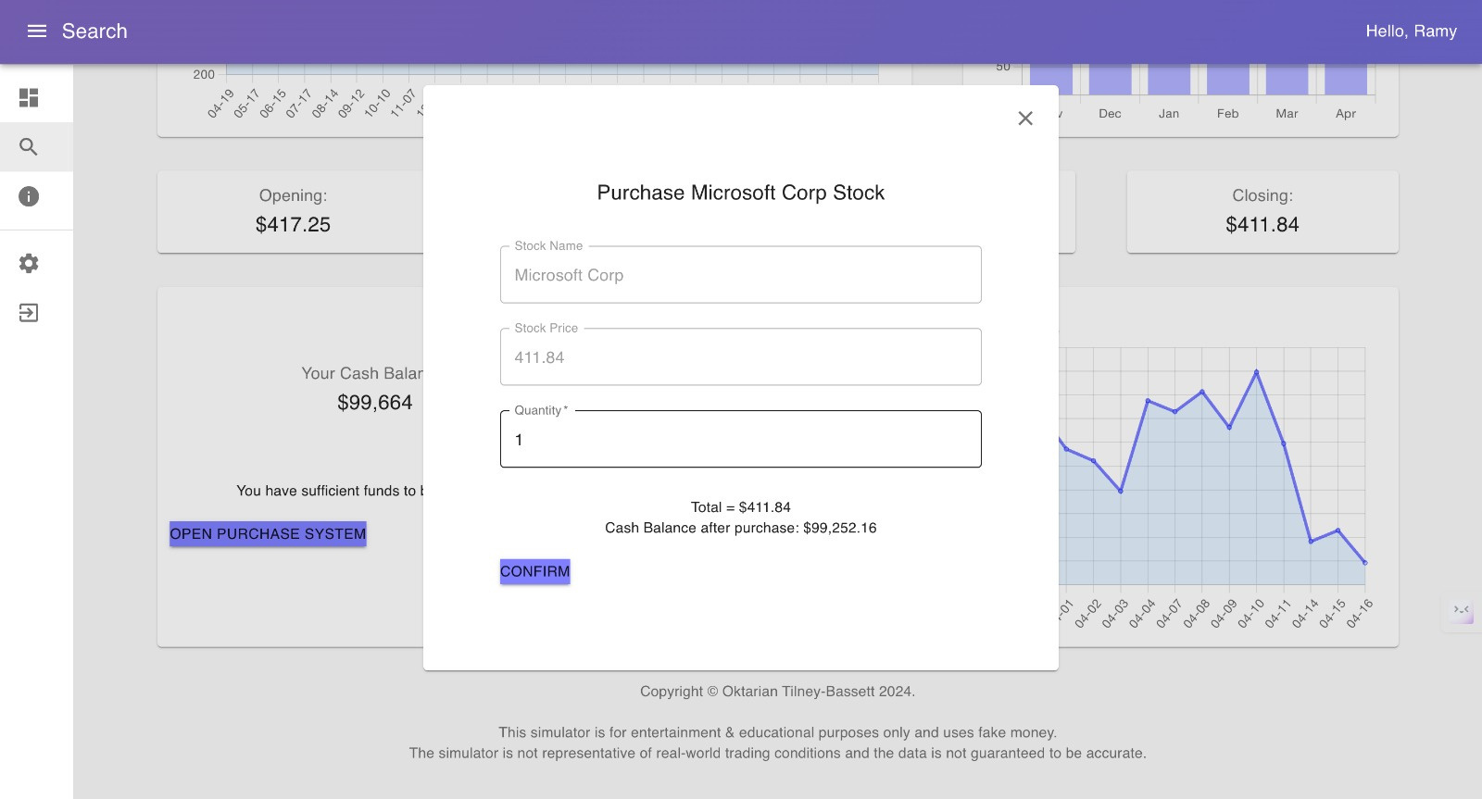

Slide 15
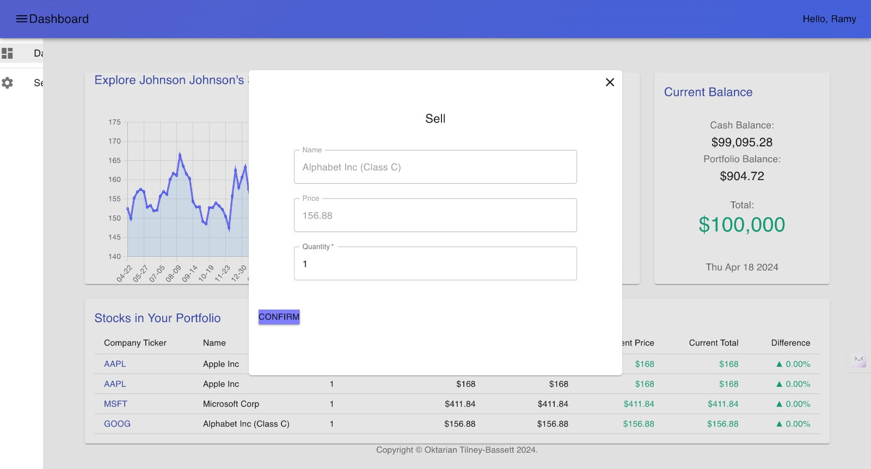

Slide 16
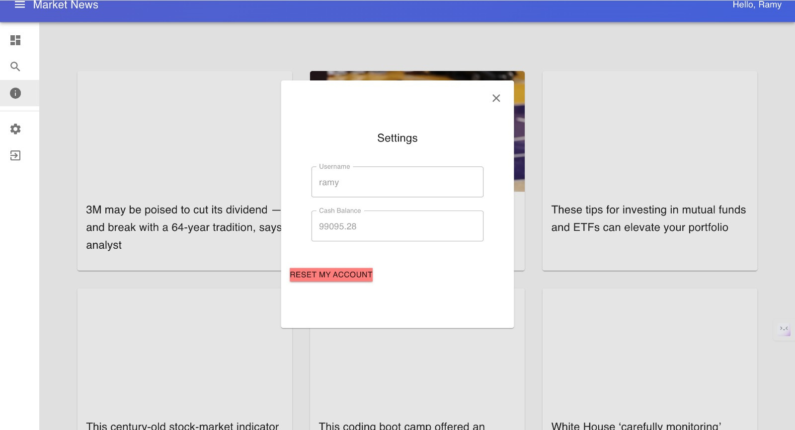

Slide 17
THANKYOU

